Slide 1
Capstone Project - The Battle of Neighborhoods
A case study for Toronto’s Tourism Association

Slide 2
Introduction/Business Problem
Toronto is the largest city if Canada and home of many touristic attractions. The city is full of museums, theatres, art galleries and festival events.
The Toronto City Culture Association heard about the capabilities of Data Science and were interested in a working with us to create a recommendation system for city visitors, based on where they planned to stay.
As such, they contacted us, proposing the project with a list of requirements.
Requirements
- The system should be capable of get the list of all cultural places in Toronto, worth visiting (e.g. Museums);
- Be able to rate the places according to typical user experience
- Get the top 3 cultural places
- Cluster the selected places by Neighbourhood
- Display the results Graphically on a map
- Create bar graphs analysing the results

Slide 3
Data
In order to be able to carry out this project we need data from a few sources:
1) Wikipedia website - we need the information regarding the Boroughs and Neighbourhoods of Toronto - https://en.wikipedia.org/wiki/List_of_postal_codes_of_Canada:_M

Slide 4
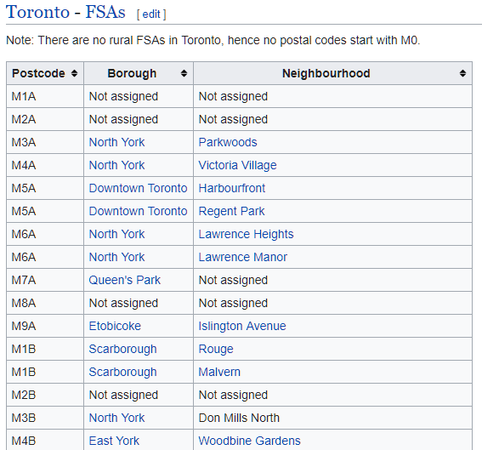
Data

Slide 5
Data
2) Foursquare website:
- from here we can extract the information about the list of all Cultural venues of Toronto
- we can also see the popularity of each venue to create our top list

Slide 6
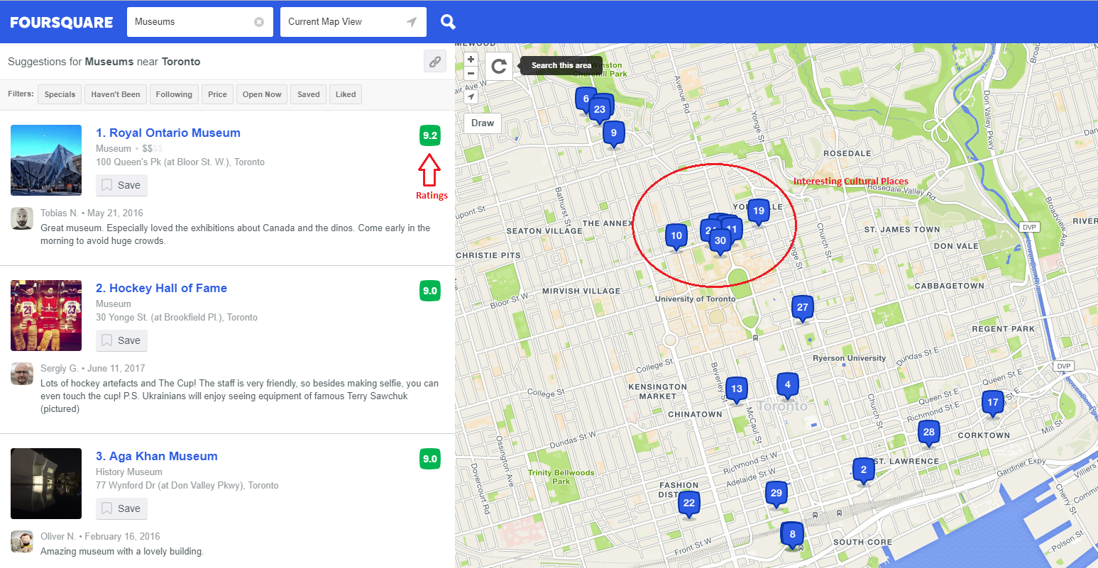
Data

Slide 7
Data
3) Geospatial_Coordinates.csv file which contains the coordinates for each Toronto PostCode

Slide 8
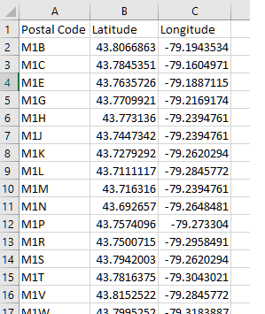
Data

Slide 9
methodology
The approach to achieve this work was fundamentally the following:
1 – Getting the data
2 – Cleaning and preparing the data sets
3 – Create Machine learning Clusters
4 – Plot graphs for graphical analysis
5 – Plot bar charts to make conclusions

Slide 10
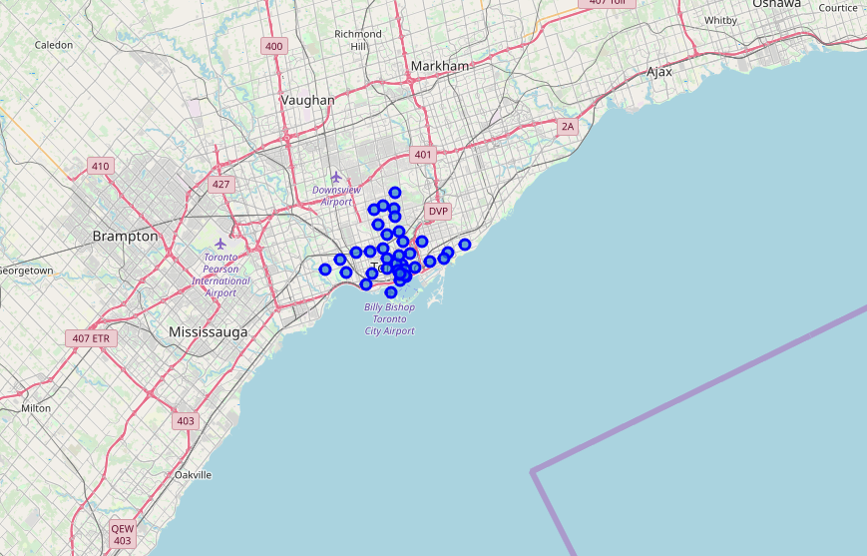
Visualization
The neighbourhoods we loaded

Slide 11
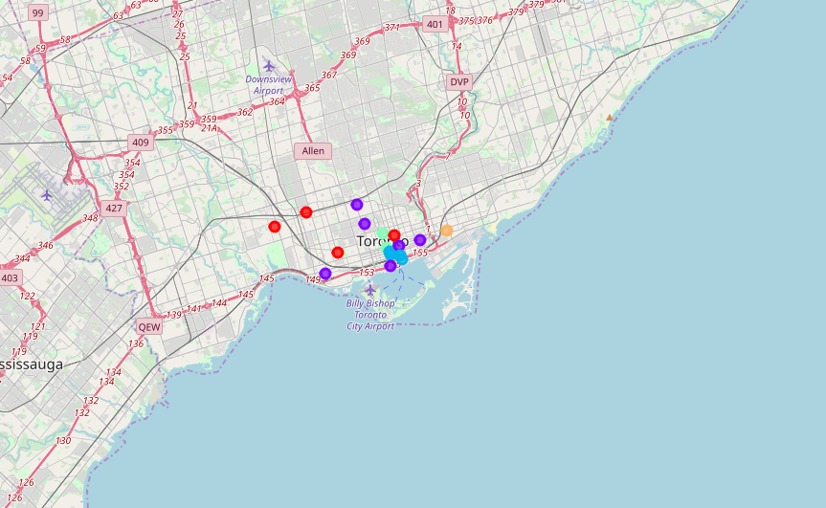
Visualization
The clusters of Avenues created

Slide 12
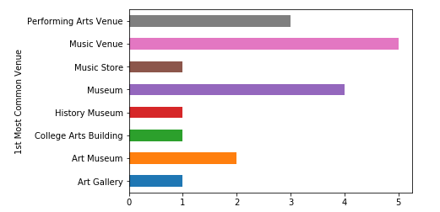
Visualization
The most sought-after Avenue across all neighbourhoods

Slide 13
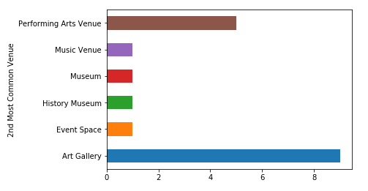
Visualization
The second sought-after Avenue across all neighbourhoods

Slide 14
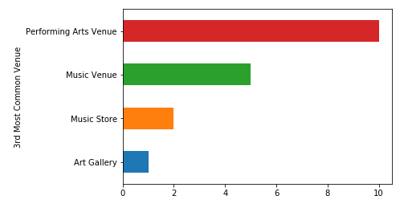
Visualization
The third sought-after Avenue across all neighbourhoods

Slide 15
results
From the combination of this data set we can conclude:
The density of Avenue clusters indicated by the graph chart;
The most sought-after Avenue across all neighbourhoods is Music Avenue
The second sought-after Avenue across all neighbourhoods is Art Gallery
The third sought-after Avenue across all neighbourhoods is Performing Arts Venue
The most common avenue by Neighbourhood given by the following table:

Slide 16
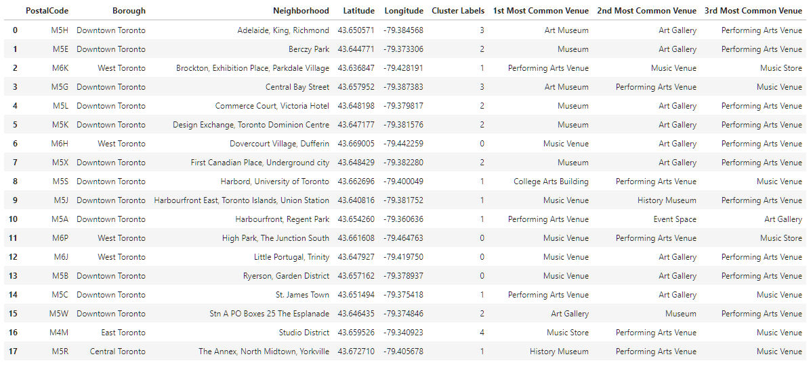
results

Slide 17
discussion
We can clearly see that the most overall rated cultural place is "Performing Arts Venue" followed by "Music Avenue" when combining all the data. Therefore, our advice to the stakeholders would be to increase this particular Avenue type if possible and make sure to also increase the budget on marketing the other cultural avenues as well to help promoting them for the city

Slide 18
conclusions
The analysis of this data is rather limited because we were to use Foursquare. The basis for the ranking positions is based on this platform and are given by users directly. It’s possible to have different results if the data set were other than Foursquare, for example, official data provided by some Government division.
The Clustering function can be changed and will yield different clusters. We assumed 5, but stakeholders can change this at will.
Was interesting to note that Museums, are popular but not as much as one might think.
Given the time allowed and the limited data, this was an interesting project that could very well benefit the Tourism agencies of Toronto!

Slide 19

Thank you ☺
Thanks for taking the time to review my work!
As an appreciation gesture, here’s a cool potato for you:

